Slide 1

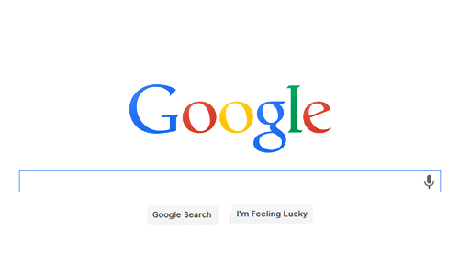

Google SEO
CHƯƠNG TRÌNH ĐÀO TẠO NHÂN VIÊN
Trình bày: Vũ Quang Sơn
HANOI – NOV, 2015

Slide 2

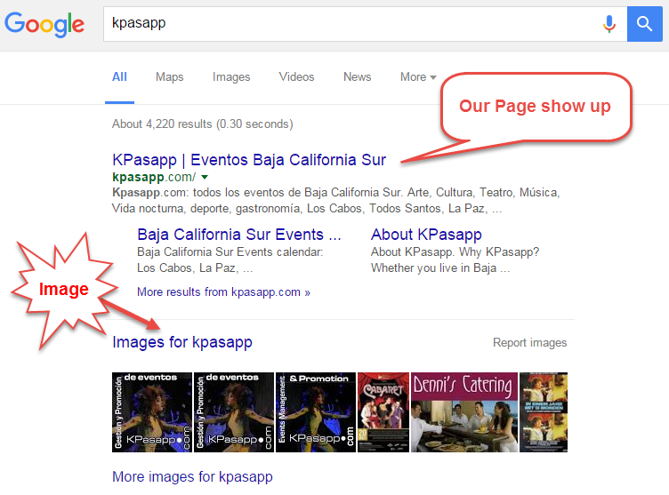
What’s
Search Engine Optimization (SEO)
Effort to increase rank in SERP

Slide 3



Why SEO matter?

Slide 4
SEO, how?
Meta tag
Open Graph
Twitter Card
Part I
Schema.org, Structured data
Clean and meaningful URL

Slide 5
SEO, how?
Optimize images
Google Webmaster Tool
Wordpress Plugin
Part II
Extra
Q&A

Slide 6
SEO, how?
Meta tag
Open Graph
Twitter Card
Part I
Schema.org, Structured data
Clean and meaningful URL

Slide 7
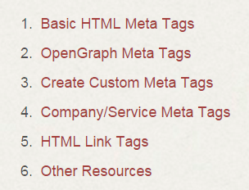
What’s Meta tag?
Texts tell SE about web content
Don’t appear on page, only in code (<head>)
Several kinds
Complete list of meta tags

Slide 8
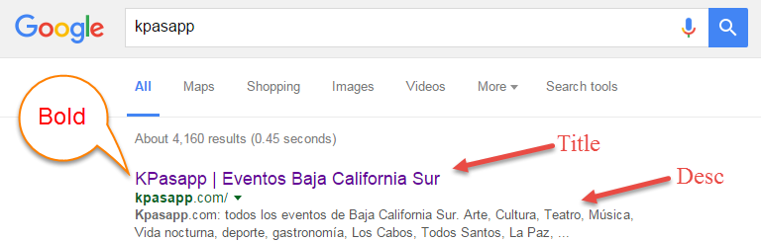
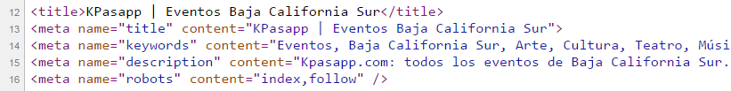
How to use Meta tag?

Slide 9
Does Meta tag help SEO?
Yes, but not all
Title - most important! ~ 55 chars
Keywords - doesn’t make much sense now
Description - quite useful, attract visitor, ~155 chars
Robots - SE crawlers (robots/bots)
index/noindex
follow/nofollow
Notes:
the fact that Baidu’s Chinese-language search engine considers the keywords and description meta tag a major factor in its search algorithm

Slide 10
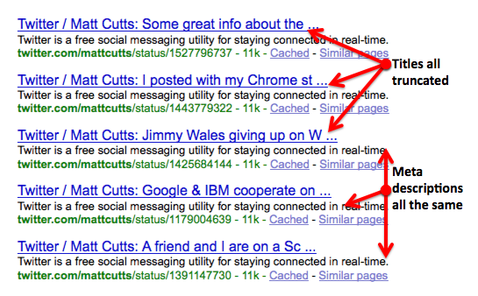
Best practice (MetaTag)
Don’t put too long/short title and meta
Avoid missing/duplicate/non-informative title and meta

Slide 11
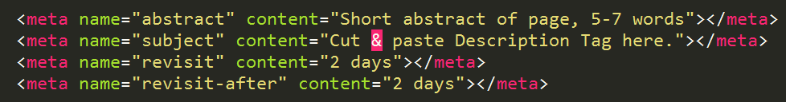
Meta not recommend to use
Title & Description is enough
Google bots is smart, u can’t ask them what to do

Slide 12

SEO, how?
Meta tag
Open Graph
Twitter Card
Part I
Schema.org, Structured data
Clean and meaningful URL

Slide 13


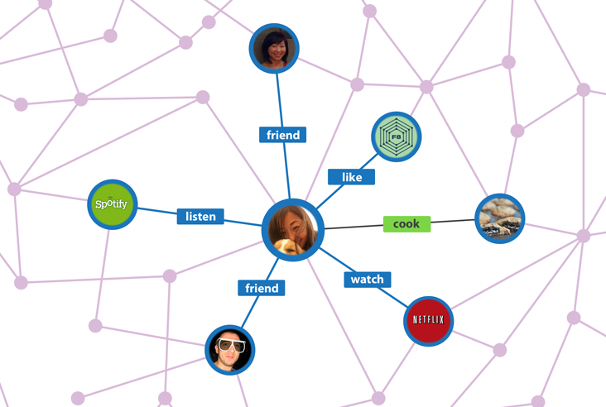
Open Graph Meta
Enables page become a
rich object in a social graph

Slide 14
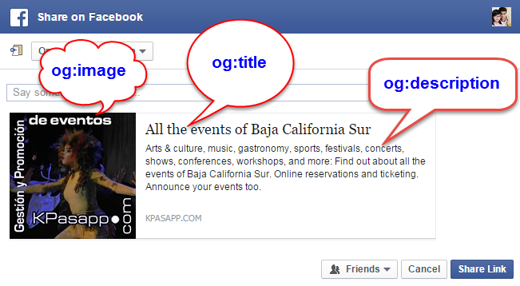
Open Graph Preview

Slide 15
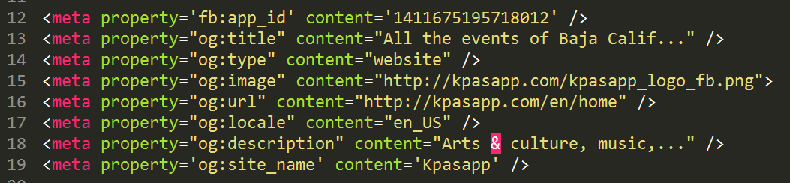
Open Graph, how to?
Required*:
title
type
image
url

Slide 16
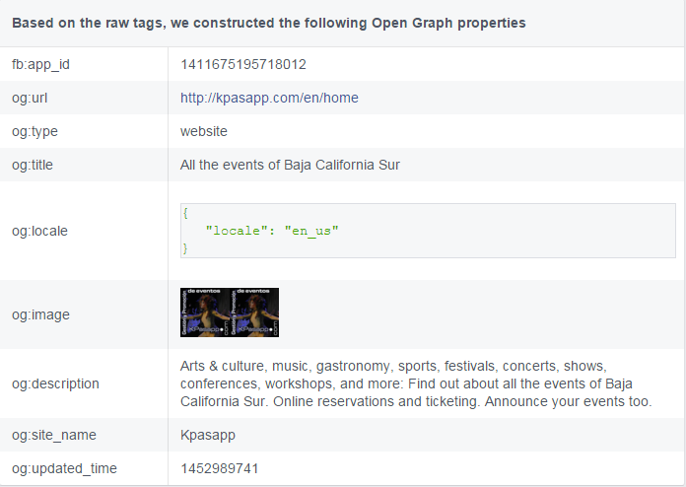
Open Graph, debug, update?
https://developers.facebook.com/tools/debug/
Notes:
https://developers.facebook.com/tools/debug/

Slide 17





Open Graph, result?
Pinterest 60% increase in visits
Pose 5X increase in daily web signup
Foodily 4X increase in new users
Fab.com 50% increase in traffic from FB
Artfinder 60% increase in time spent
https://developers.facebook.com/blog/post/2012/02/15/early-success-stories--timeline-apps-and-open-graph/
Notes:
https://developers.facebook.com/tools/debug/

Slide 18
SEO, how?
Meta tag
Open Graph
Twitter Card
Part I
Schema.org, Structured data
Clean and meaningful URL

Slide 19
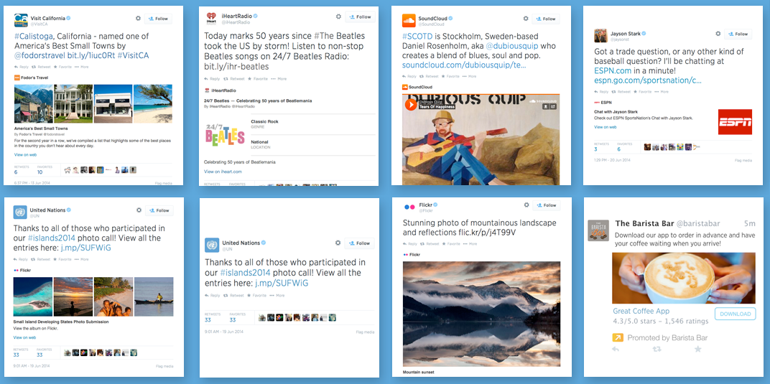
Twitter card overview
Types: Summary, Photo, Gallery, App, Player, Product
Notes:
https://developers.facebook.com/tools/debug/

Slide 20
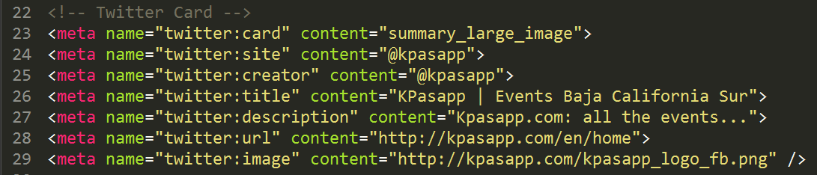
Twitter card, how?
Required*:
card
site
title
description
Notes:
https://developers.facebook.com/tools/debug/

Slide 21
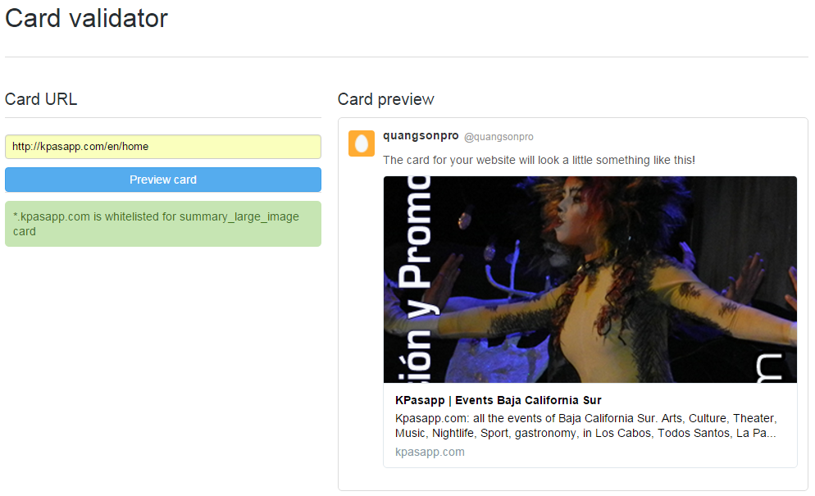
Twitter card, debug?
https://cards-dev.twitter.com/validator
Notes:
https://developers.facebook.com/tools/debug/

Slide 22
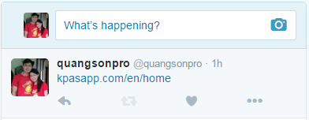
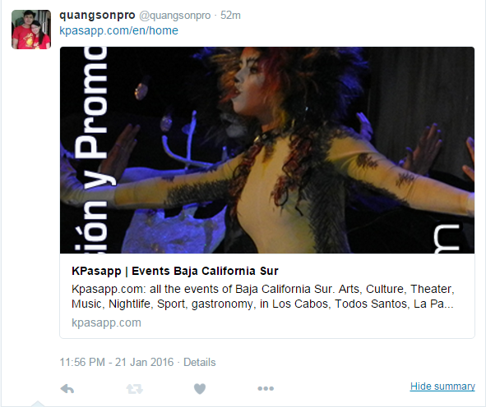
Twitter card, result?
After
Before
Notes:
https://developers.facebook.com/tools/debug/

Slide 23
SEO, how?
Meta tag
Open Graph
Twitter Card
Part I
Schema.org, Structured data
Clean and meaningful URL

Slide 24

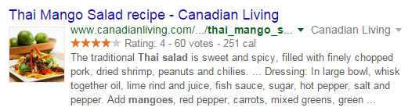
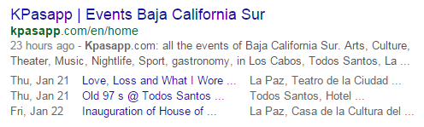
Schema.org, Structured Data
Product
Recipes
Events

Slide 25
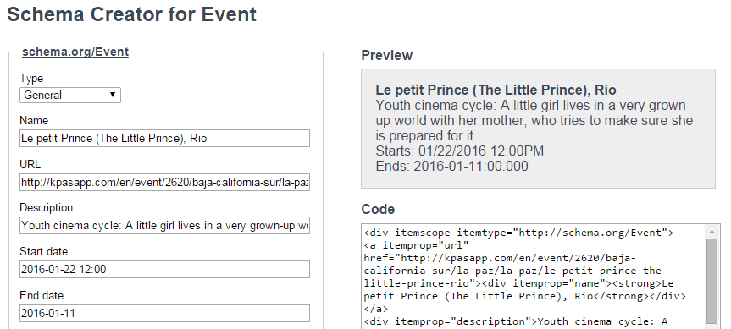
Structured Data, how to?
http://schema-creator.org/event.php

Slide 26
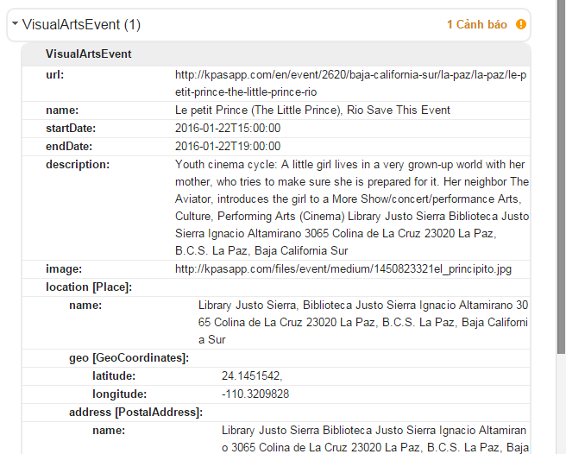
Structured Data, debug?
https://developers.google.com/structured-data/testing-tool/

Slide 27
SEO, how?
Meta tag
Open Graph
Twitter Card
Part I
Schema.org, Structured data
Clean and meaningful URL

Slide 28
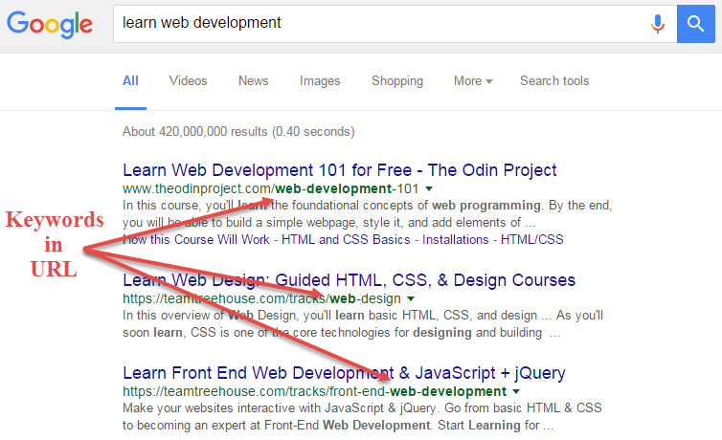
Clean and meaningful URL, why?

Slide 29
Clean and meaningful URL
Puppies confused
http://mydomain.com/puppies-adorably-confused-by-rainbow
http://www.mydomain.com/pub/post?ID=77&kw=puppies+confused
http://cdn07.mydomain.cc/9rf7e2/i?HXID=iaj34089jgt30hgqa3&qry=f#loaddelay

Slide 30
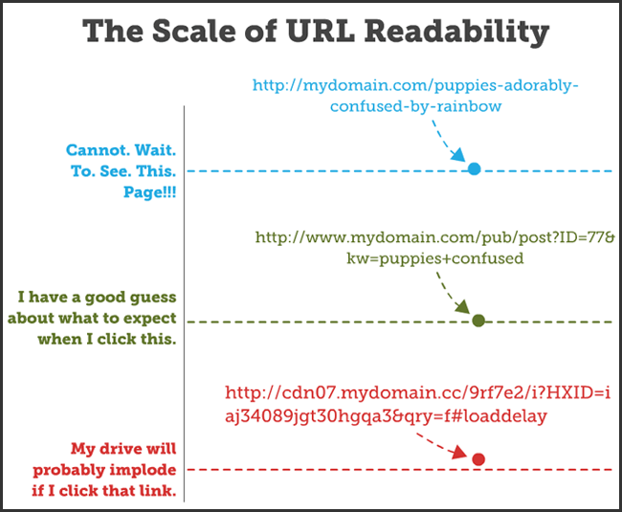
Clean and meaningful URL

Slide 31
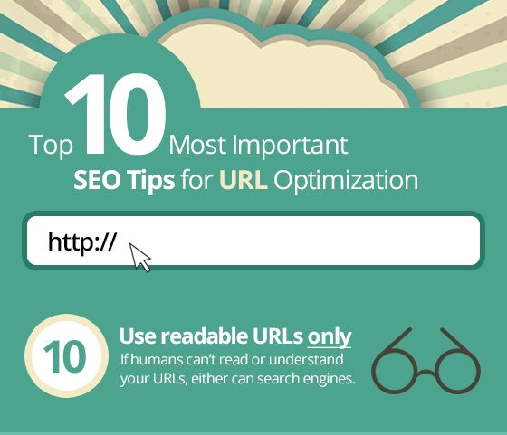
Clean and meaningful URL
Good
www.example.com/topic-name
Bad
www.example.com/?p=578544
Very Bad
www.example.com/shop/
bed-bath/quilts-bedspreads?
id=22748&edge=hybrid&
cm_sp=us_catsplash_bed-%
26-bath-_-row6-_-quilts-%
26-bedspreads
Notes:
http://mysiteauditor.com/blog/top-10-most-important-seo-tips-for-url-optimization/

Slide 32
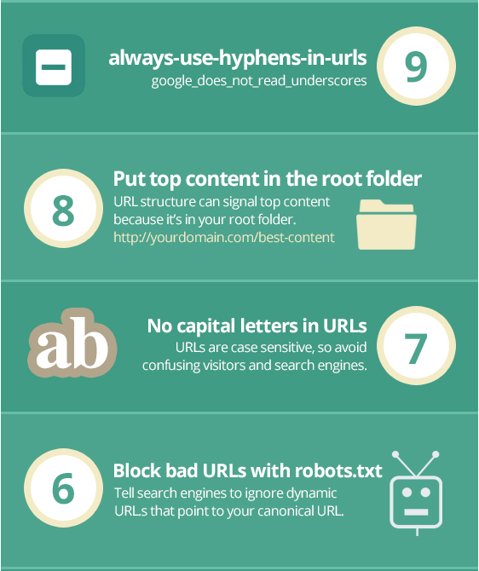
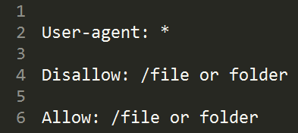
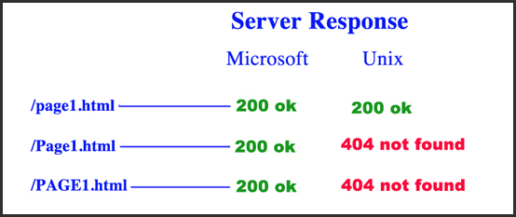
Good
www.example.com/best-content
Bad
www.example.com/sub/Bad_Link

Slide 33
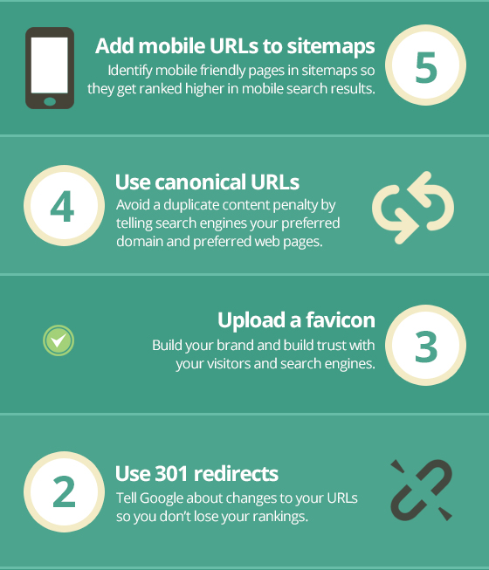

Slide 34
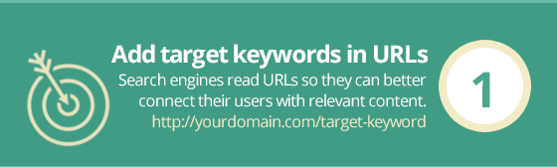
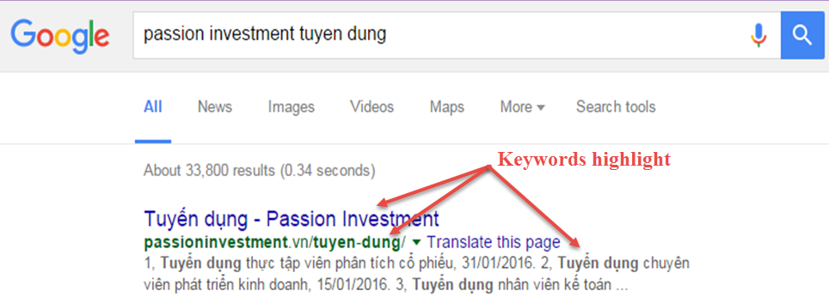
Clean and meaningful URL

Slide 35
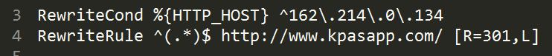
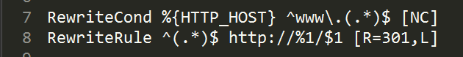
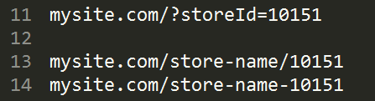
Clean URL (extra)
IP host and domain
www and non-www domain
Parameter (URL ~ 50 – 60 chars)
Notes:
http://mysiteauditor.com/blog/top-10-most-important-seo-tips-for-url-optimization/

Slide 36
SEO, how?
Optimize images
Google Webmaster Tool
Wordpress Plugin
Part II
Extra
Q&A

Slide 37
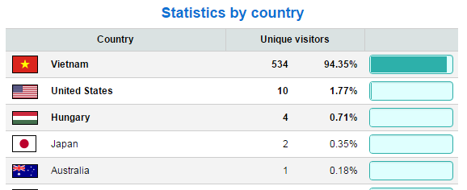
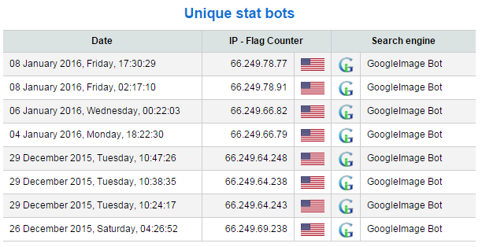
Optimize images

Slide 38
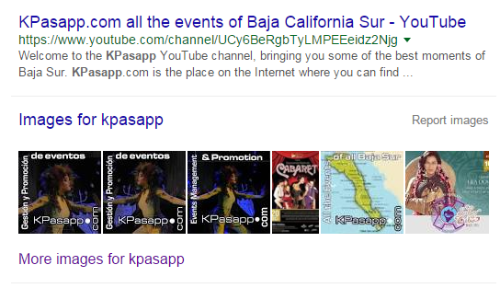
Optimize images

Slide 39
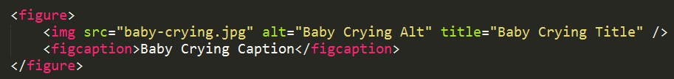

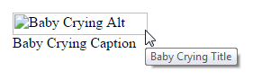
Optimize images
Alt text (important for crawlers), Title, Name, Caption ~16 words
File size
File as small as possible
Resize image before show
Notes:
https://www.searchenginejournal.com/image-alt-text-vs-image-title-whats-the-difference/

Slide 40
SEO, how?
Optimize images
Google Webmaster Tool
Wordpress Plugin
Part II
Extra
Q&A

Slide 41
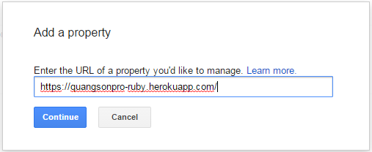
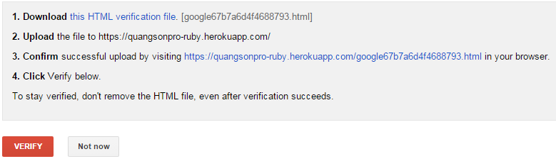
Google webmaster Tool
Verify your website

Slide 42
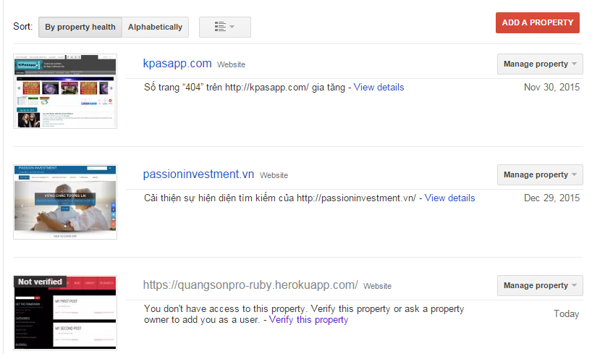
Google webmaster Tool
List websites managed

Slide 43
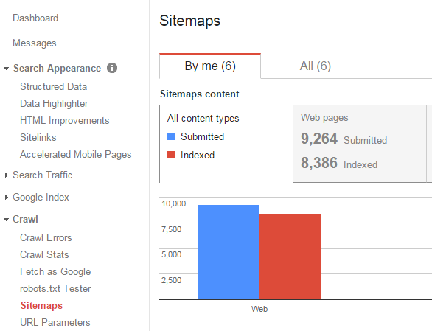
GWT, Sitemap

Slide 44
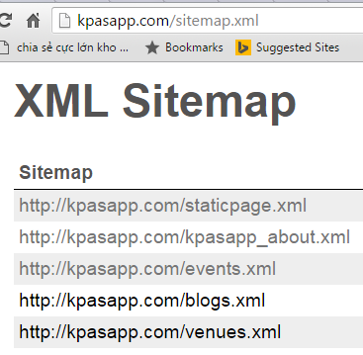
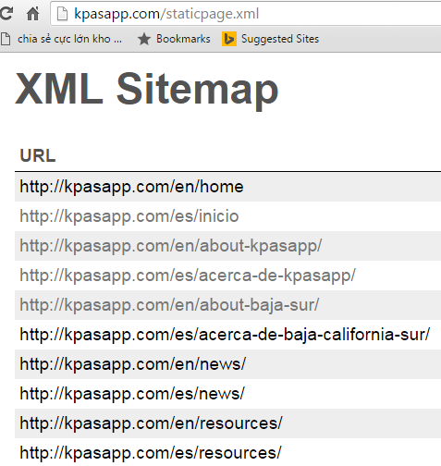
GWT, Sitemap

Slide 45
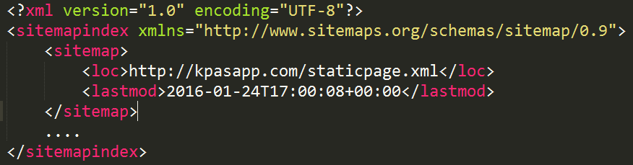
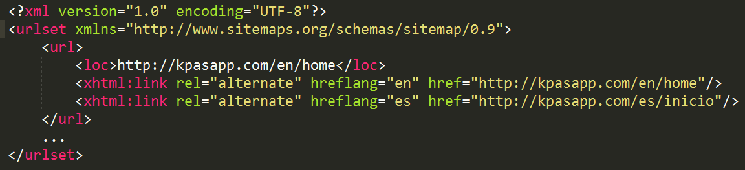
GWT, Sitemap
http://kpasapp.com/sitemap.xml
http://kpasapp.com/staticpage.xml

Slide 46
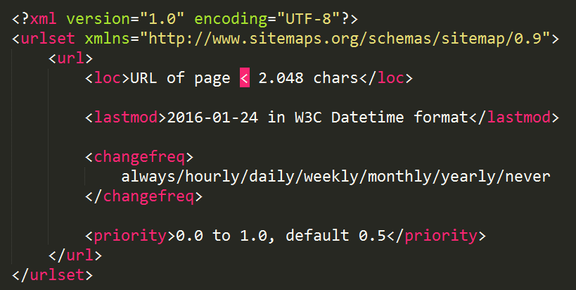
GWT, Sitemap
Some notes

Slide 47
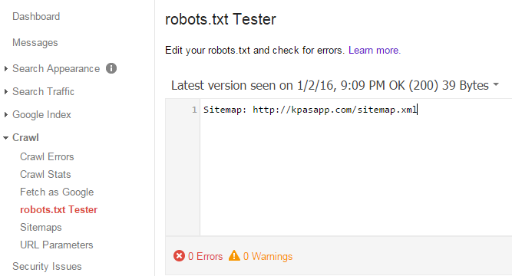
GWT, robots.txt

Slide 48
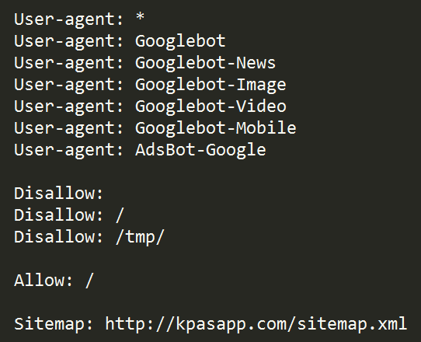
GWT, robots.txt
http://kpasapp.com/robots.txt must be located at root

Slide 49
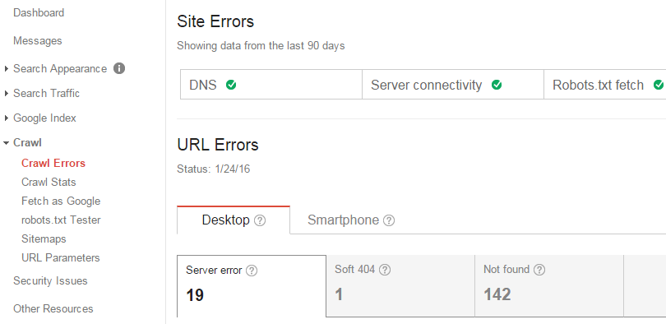
GWT, site errors

Slide 50
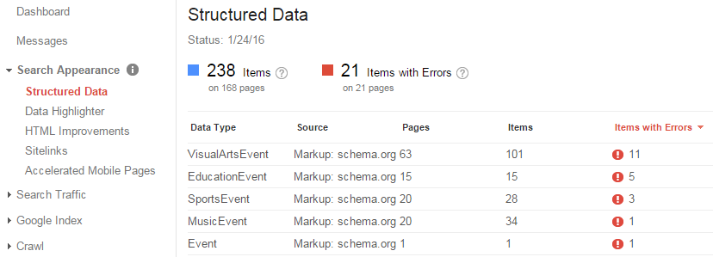
GWT, structured data

Slide 51

GWT, structured data

Slide 52
SEO, how?
Optimize images
Google Webmaster Tool
Wordpress Plugin
Part II
Extra
Q&A

Slide 53


Wordpress (plugin)
Yoast SEO
All in One SEO Pack

Slide 54

Yoast SEO before

Slide 55

Yoast SEO after

Slide 56
Yoast recommend
Easy to read (11-yr old child), > 300 words, has outbound link
https://readability-score.com/
Title is 40 ~ 70 chars
Keyword density:
URL, Desc, img’s alt, Title at beginning, Subheadings , first <p>, more…
Never used Keyword before

Slide 57
SEO, how?
Optimize images
Google Webmaster Tool
Wordpress Plugin
Part II
Extra
Q&A

Slide 58

Extra
http://backlinko.com/google-ranking-factors
Keyword Appears in Top Level Domain
Keyword As First Word in Domain
Page Loading Speed
Number of Comments
And more…

Slide 59
Reference
http://code.lancepollard.com/complete-list-of-html-meta-tags/
http://www.wordstream.com/meta-tags
http://searchengineland.com/figz/wp-content/seloads/2013/10/nofollowtag-1000-2919.png
https://moz.com/learn/seo/meta-description
http://webmasters.stackexchange.com/questions/403/how-should-i-structure-my-urls-for-both-seo-and-localization

Slide 60
Reference (cont)
https://yoast.com/flesch-reading-ease-score/
http://www.cyberalert.com/blog/index.php/the-guide-to-creating-and-optimizing-metadata-for-seo/
http://diythemes.com/thesis/wordpress-seo-image-optimization/
http://backlinko.com/google-ranking-factors
http://www.webmarketingnow.com/tips/meta-tags-uncovered.html

Slide 61
Reference (cont)
http://schema-creator.org/event.php
http://mysiteauditor.com/blog/top-10-most-important-seo-tips-for-url-optimization/
https://www.searchenginejournal.com/five-steps-to-seo-friendly-site-url-structure/
http://www.wordtracker.com/academy/learn-seo/technical-guides/seo-clean-urls
https://moz.com/blog/15-seo-best-practices-for-structuring-urls

Slide 62
Reference (cont)
https://developers.facebook.com/tools/debug/
http://ogp.me/
https://davidwalsh.name/twitter-cards
http://www.sitemaps.org/protocol.html

Slide 63
SEO, how?
Optimize images
Google Webmaster Tool
Wordpress Plugin
Part II
Extra
Q&A

Slide 64


Slide 65
THANK YOU!

